Slide 1
Kernel of Linear Map
Let V and W be vector spaces and let F : V→W be a linear map.
The set of elements v ∈ V such that F(v) = 0 is called the kernel of F, and is denoted as Ker(F).
Kernel is also known as nullspace of F.
Ker(F) = { v ∈ V : F(v ) = 0 }
V
W
0
F
Ker(F)

Slide 2
Let V and W be vector spaces and let F : V→W be a linear
map.
The set of elements v ∈ V such that F(v)=0 is called the
kernel of F,
The kernel of F is a subspace of V.
Proof :
Let v , w be in the kernel.
Since F(0) = 0, so 0 is in the kernel.
Then F(v + w) = 0 = 0 + 0 = F(v) + F(w) , so that v + w is in the kernel.
If c is a number, then F(cv) = 0 = c.0 = cF(v) , so that cv is also in the kernel.
Hence , the kernel is a subspace.
F
V
W
Vector Space
Ker(F) = { v ∈ V : F(v ) = 0 }
Ker(F) = { v ∈ V : F(v ) = 0 }
All elements in Kernel are from V
Ker(F) is subset of V
Ker(F) is vector space over F (from {1},{2} and {3})
Ker(F) is subspace of V
Let V be a vector space, and let H be a subset of V. Assume that H satisfies the following conditions.
If u , v ∈ H, then u + v ∈ H
If v ∈ H, then cv ∈ H
The element 0 of V is also an element of H
Then H itself is a vector space, under the operations already defined in V. We shall call H a subspace of V.

Slide 3

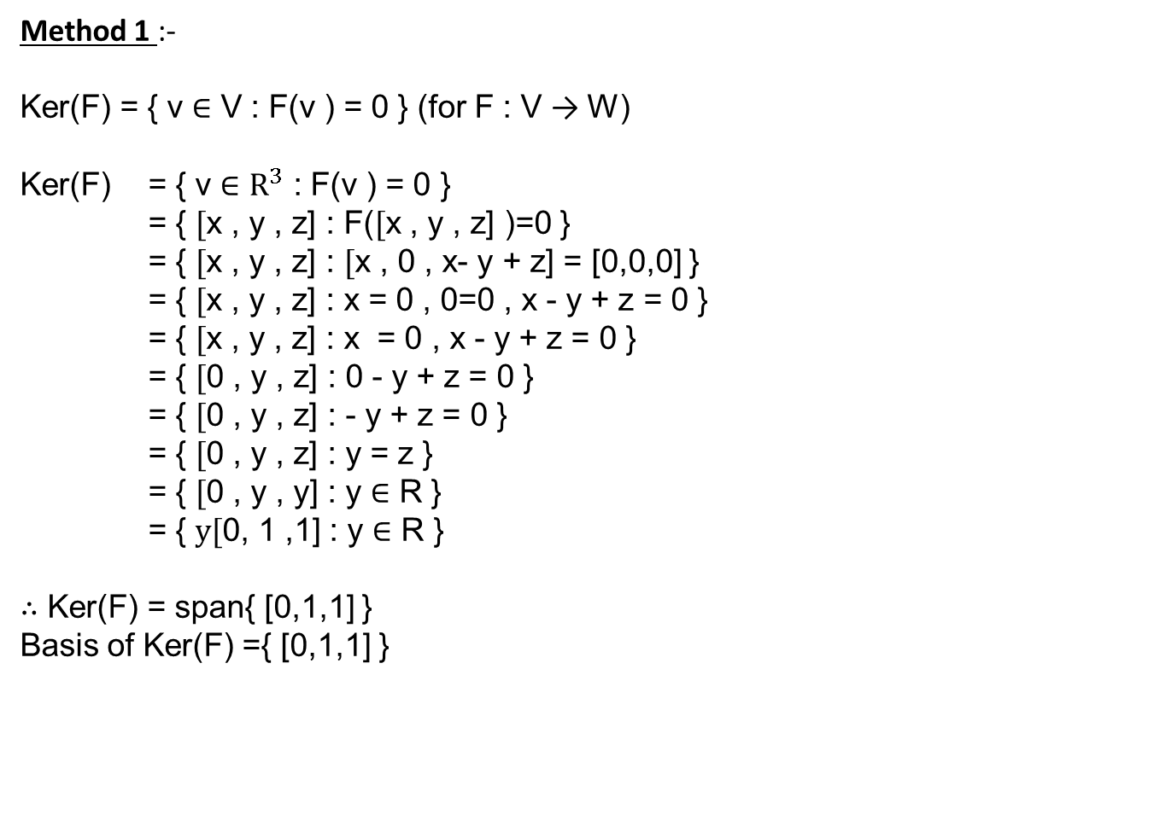
Kernel of Linear Map
Question : Let F$:R^{3}$ → $R^{3} b$e the linear transformation, such that F(x, y, z) = (x , 0 , x-y+z) $.$ Find Kernel of F.
Method 1 :-
Ker(F) = { v ∈ V : F(v ) = 0 } (for F : V → W)
Ker(F) = { v ∈ $R^{3}$ : F(v ) = 0 }
= { $[$x , y , z] : F($[$x , y , z] )=0 }
= { $[$x , y , z] : $[$x , 0 , x- y + z] = [0,0,0] }
= { $[$x , y , z] : x = 0 , 0=0 , x - y + z = 0 }
= { $[$x , y , z] : x = 0 , x - y + z = 0 }
= { $[$0 , y , z] : 0 - y + z = 0 }
= { $[$0 , y , z] : - y + z = 0 }
= { $[$0 , y , z] : y = z }
= { $[$0 , y , y] : y ∈ R }
= { $y[$0, 1 ,1] : y ∈ R }
$∴$ Ker(F) = span{ [0,1,1] }
Basis of Ker(F) ={ [0,1,1] }

Slide 4
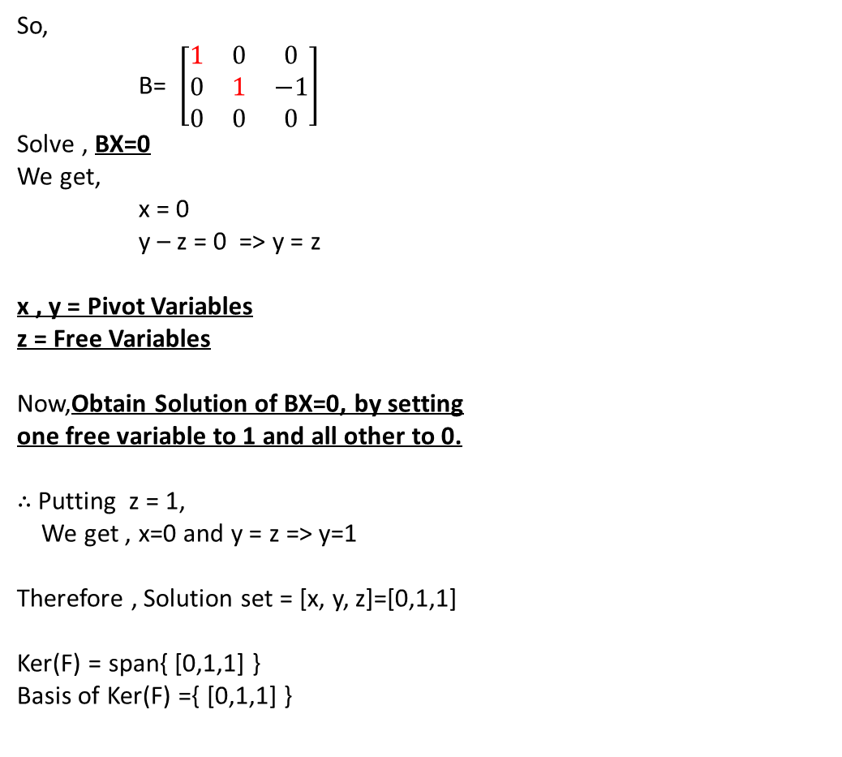
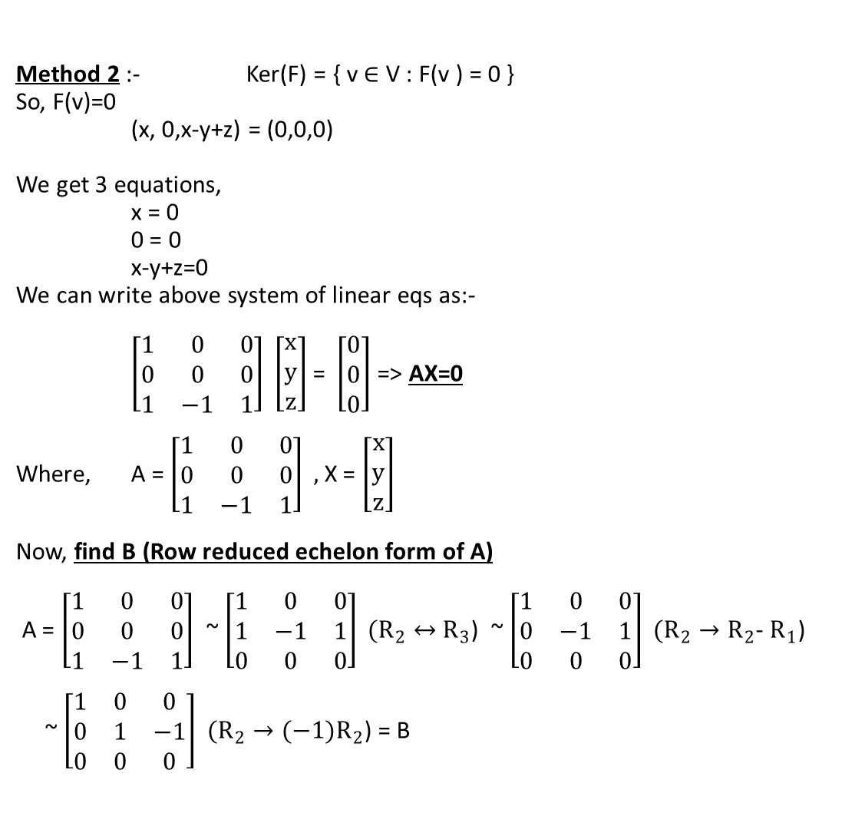
Kernel of Linear Map
Question : Let F$:R^{3}$ → $R^{3} b$e the linear transformation, such that F(x, y, z) = (x , 0 , x-y+z) $.$ Find Kernel of F.
Method 2 :- Ker(F) = { v ∈ V : F(v ) = 0 }
So, F(v)=0
(x, 0,x-y+z) = (0,0,0)
We get 3 equations,
x = 0
0 = 0
x-y+z=0
We can write above system of linear eqs as:-
$\left[\begin{matrix}1 & 0 & 0 \\ 0 & 0 & 0 \\ 1 & −1 & 1\end{matrix}\right] \left[\begin{matrix}x \\ y \\ z\end{matrix}\right]$= $\left[\begin{matrix}0 \\ 0 \\ 0\end{matrix}\right]$=> AX=0
Where, A = $\left[\begin{matrix}1 & 0 & 0 \\ 0 & 0 & 0 \\ 1 & −1 & 1\end{matrix}\right] ,$ X = $\left[\begin{matrix}x \\ y \\ z\end{matrix}\right]$
Now, find B (Row reduced echelon form of A)
A = $\left[\begin{matrix}1 & 0 & 0 \\ 0 & 0 & 0 \\ 1 & −1 & 1\end{matrix}\right]$ ~ $\left[\begin{matrix}1 & 0 & 0 \\ 1 & −1 & 1 \\ 0 & 0 & 0\end{matrix}\right] (R_{2}↔$ $R_{3}$) ~ $\left[\begin{matrix}1 & 0 & 0 \\ 0 & −1 & 1 \\ 0 & 0 & 0\end{matrix}\right] (R_{2}→R_{2}$- $R_{1}$)
~ $\left[\begin{matrix}1 & 0 & 0 \\ 0 & 1 & −1 \\ 0 & 0 & 0\end{matrix}\right] (R_{2}→{(−1)R}_{2}$) = B
x
y
z
So,
B= $\left[\begin{matrix}1 & 0 & 0 \\ 0 & 1 & −1 \\ 0 & 0 & 0\end{matrix}\right]$
Solve , BX=0
We get,
x = 0
y – z = 0 => y = z
x , y = Pivot Variables
z = Free Variables
Now,Obtain Solution of BX=0, by setting
one free variable to 1 and all other to 0.
$∴$Putting z = 1,
We get , x=0 and y = z => y=1
Therefore , Solution set = [x, y, z]=[0,1,1]
Ker(F) = span{ [0,1,1] }
Basis of Ker(F) ={ [0,1,1] }
1
1

Slide 5
Image Space of Linear Map
Let V and W be vector spaces and let F : V→W be a linear map.
The image of F is the set of elements w in W such that there exists an element v of V such that F(v) = w.
It is denoted as Im(F). (Image is also known as Range)
Im(F) = { w ∈ W : there exists v ∈ V such that F(v ) = w }
V
F
W
Im(F)

Slide 6
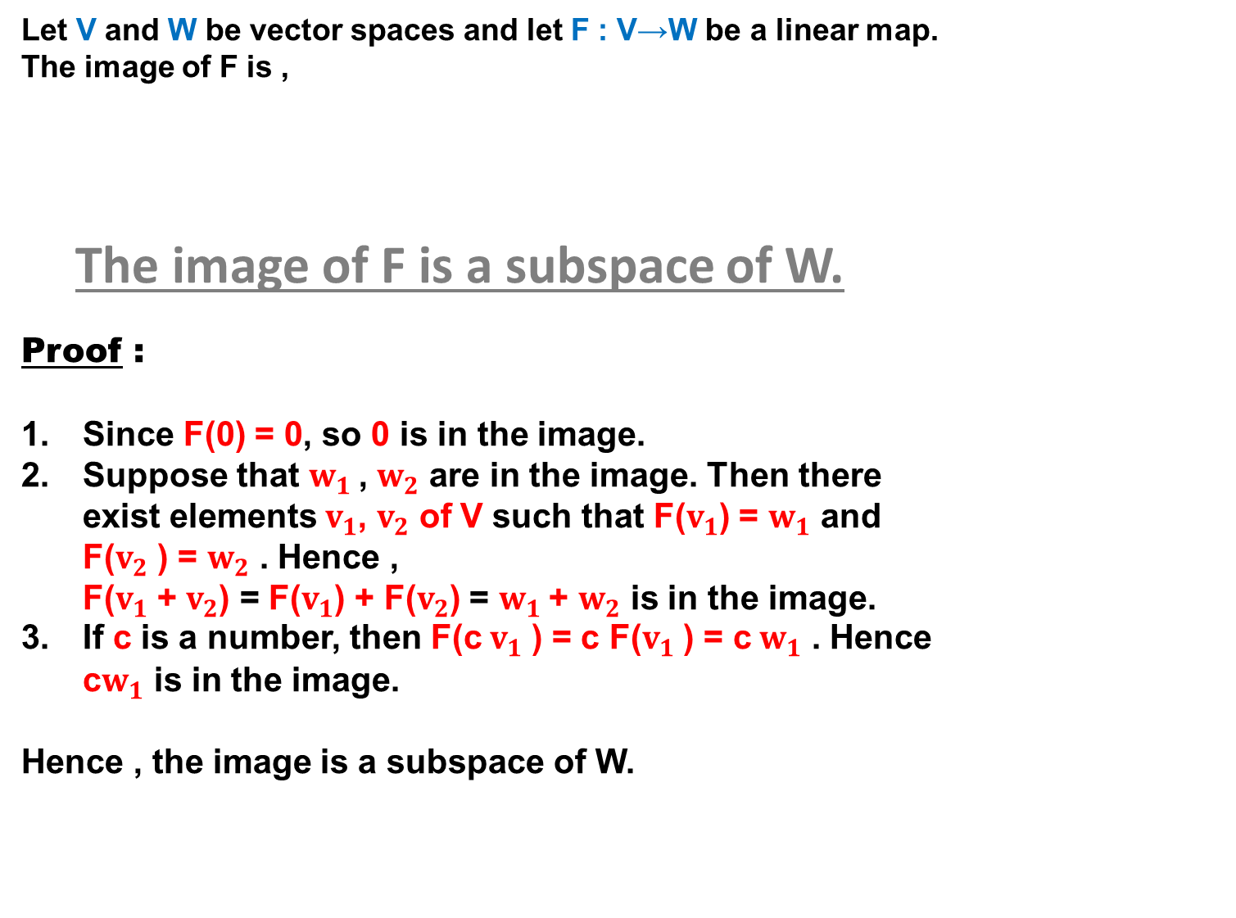
Let V and W be vector spaces and let F : V→W be a linear map.
The image of F is ,
The image of F is a subspace of W.
Proof :
Since F(0) = 0, so 0 is in the image.
Suppose that $w_{1}$, $w_{2}$ are in the image. Then there exist elements$v_{1}$, $v_{2}$ of V such that F($v_{1}$) = $w_{1}$ and F($v_{2}$ ) = $w_{2}$ . Hence , F($v_{1}$ + $v_{2}$) = F($v_{1}$) + F($v_{2}$) = $w_{1}$+ $w_{2}$ is in the image.
If c is a number, then F(c $v_{1}$ ) = c F($v_{1}$ ) = c $w_{1}$ . Hence c$w_{1}$ is in the image.
Hence , the image is a subspace of W.
F
V
W
Im(F) = { w ∈ W : there exists v ∈ V such that F(v ) = w }
Vector Space
Im(F) = { w ∈ W : there exists v ∈ V such that F(v ) = w }
All elements in image are from W
Im(F) is subset of W
Im(F) is vector space over F (from {1},{2} and {3}) because Im(F) is closed under vector addition and scalar multiplication
Im(F) is subspace of W

Slide 7
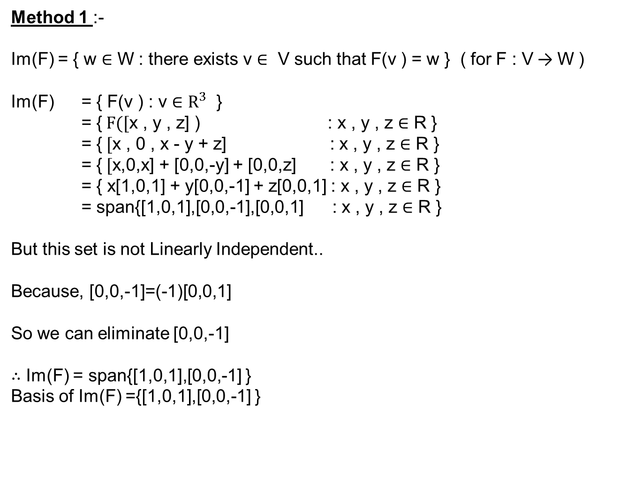
Image/Range of Linear Map
Question : Let F$:R^{3}$ → $R^{3} b$e the linear transformation, such that F(x, y, z) = (x , 0 , x-y+z) $.$ Find Image of F.
Method 1 :-
Im(F) = { w ∈ W : there exists v ∈ V such that F(v ) = w } ( for F : V → W )
Im(F) = { F(v ) : v ∈ $R^{3}$ }
= {$F([$x , y , z] ) : x , y , z ∈ R }
= {$[$x , 0 , x - y + z] : x , y , z ∈ R }
= {$[$x,0,x] + [0,0,-y] + [0,0,z] : x , y , z ∈ R }
= { x[1,0,1] + y[0,0,-1] + z[0,0,1] : x , y , z ∈ R }
= span{[1,0,1],[0,0,-1],[0,0,1] : x , y , z ∈ R }
But this set is not Linearly Independent..
Because, [0,0,-1]=(-1)[0,0,1]
So we can eliminate [0,0,-1]
$∴$ Im(F) = span{[1,0,1],[0,0,-1] }
Basis of Im(F) ={[1,0,1],[0,0,-1] }

Slide 8

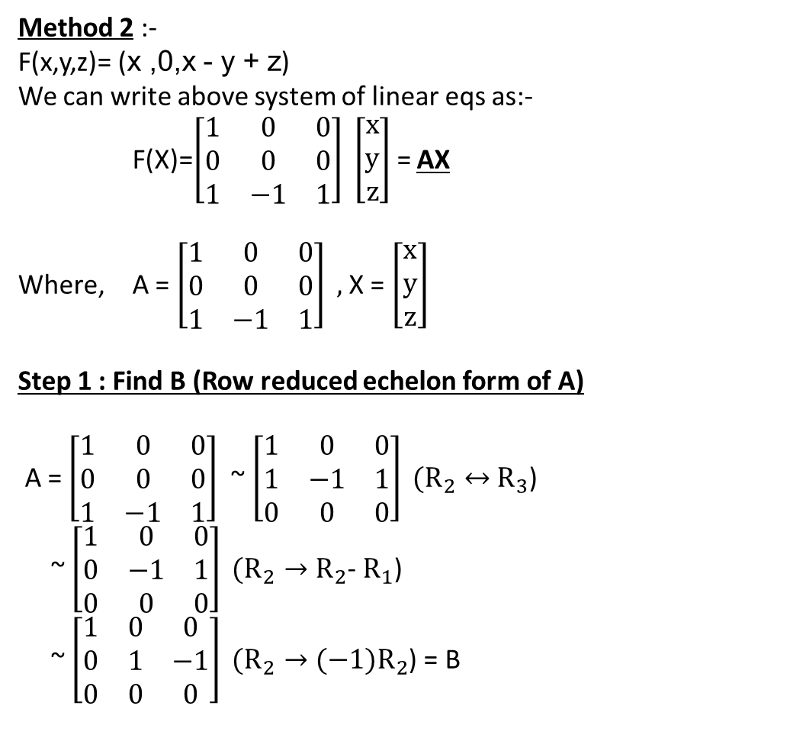




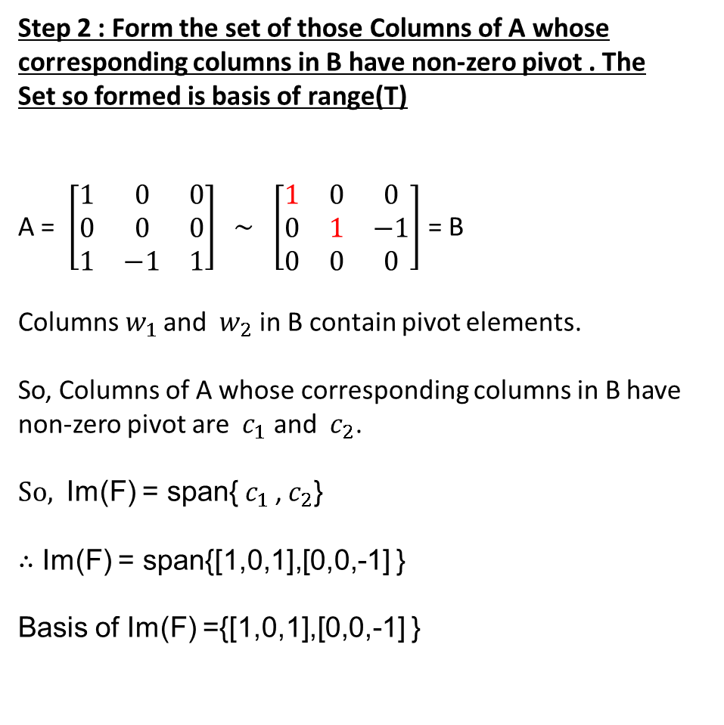

Image/Range of Linear Map
Question : Let F$:R^{3}$ → $R^{3} b$e the linear transformation, such that F(x, y, z) = (x , 0 , x-y+z) $.$ Find Image of F.
Method 2 :-
F(x,y,z)= (x ,0,x - y + z)
We can write above system of linear eqs as:-
F(X)=$\left[\begin{matrix}1 & 0 & 0 \\ 0 & 0 & 0 \\ 1 & −1 & 1\end{matrix}\right] \left[\begin{matrix}x \\ y \\ z\end{matrix}\right]$= AX
Where, A = $\left[\begin{matrix}1 & 0 & 0 \\ 0 & 0 & 0 \\ 1 & −1 & 1\end{matrix}\right] ,$ X = $\left[\begin{matrix}x \\ y \\ z\end{matrix}\right]$
Step 1 : Find B (Row reduced echelon form of A)
A = $\left[\begin{matrix}1 & 0 & 0 \\ 0 & 0 & 0 \\ 1 & −1 & 1\end{matrix}\right]$ ~ $\left[\begin{matrix}1 & 0 & 0 \\ 1 & −1 & 1 \\ 0 & 0 & 0\end{matrix}\right] (R_{2}↔$ $R_{3}$)
~ $\left[\begin{matrix}1 & 0 & 0 \\ 0 & −1 & 1 \\ 0 & 0 & 0\end{matrix}\right] (R_{2}→R_{2}$- $R_{1}$)
~ $\left[\begin{matrix}1 & 0 & 0 \\ 0 & 1 & −1 \\ 0 & 0 & 0\end{matrix}\right] (R_{2}→{(−1)R}_{2}$) = B
Step 2 : Form the set of those Columns of A whose corresponding columns in B have non-zero pivot . The
Set so formed is basis of range(T)
A = $\left[\begin{matrix}1 & 0 & 0 \\ 0 & 0 & 0 \\ 1 & −1 & 1\end{matrix}\right] \sim$ $\left[\begin{matrix}1 & 0 & 0 \\ 0 & 1 & −1 \\ 0 & 0 & 0\end{matrix}\right]$ = B
Columns${ w}_{1}$ and ${ w}_{2}$ in B contain pivot elements.
So, Columns of A whose corresponding columns in B have non-zero pivot are ${ c}_{1}$ and ${ c}_{2}$.
$So,$ Im(F) = span{${ c}_{1}$ ,${ c}_{2}$}
$∴$ Im(F) = span{[1,0,1],[0,0,-1] }
Basis of Im(F) ={[1,0,1],[0,0,-1] }
$${ c}_{1}$$
$${ c}_{2}$$
$${ c}_{3}$$
$${ w}_{1}$$
$${ w}_{2}$$
$${ w}_{3}$$
1
1

Slide 9
One to One Linear Map
A mapping F : V→W is called one-to-one if the distinct vectors in V have different images in W.
F is one-to-one if and only if for all u and v in V,
F(u) = F(v) implies that u = v.
Onto Linear Map
A mapping F : V→W is called onto if every element in W has a preimage in V.
F is onto if for every w ∈ W , there is some v ∈ V such that,
F(v) = w.
V
W
V
W
F
F
One to One
Not One to One
Not Onto
Onto

Slide 10
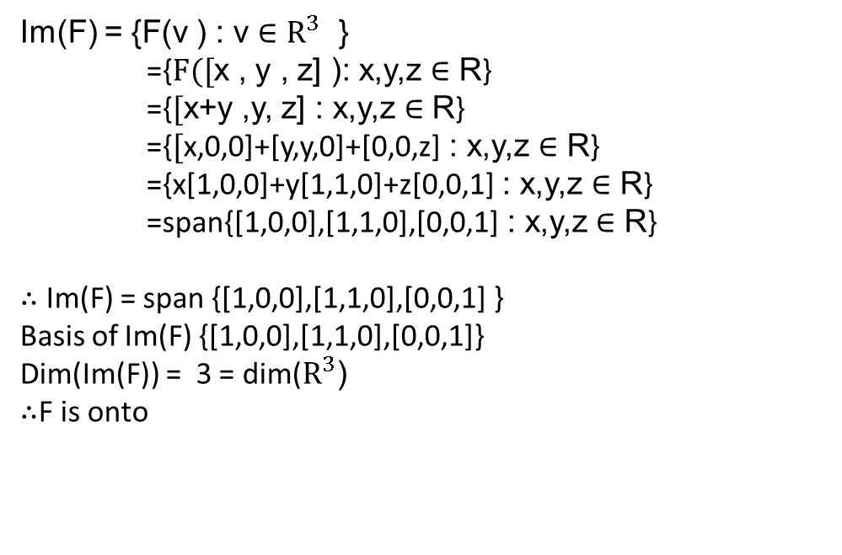
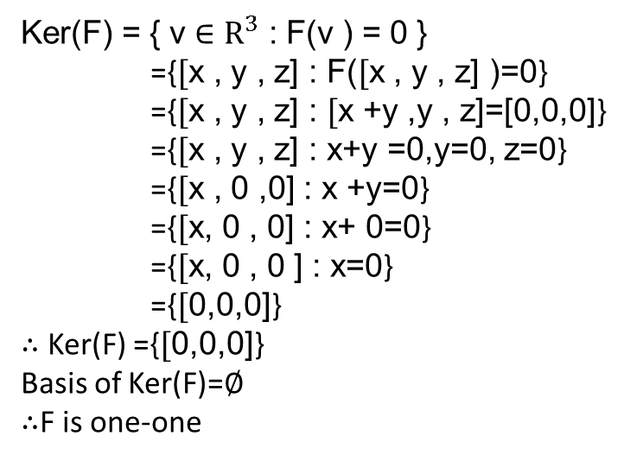
Theorem : One-One Linear Map and Kernel
Let V and W be vector spaces .
Let F : V→W be a linear map.
Then ,
F is one-to-one if and only if,
Ker(F) = { 0 }
Theorem : Onto Linear Map and Range
Let V and W be vector spaces .
Let F : V→W be a linear map.
If W is finite dimensional,Then ,
F is onto if and only if,
dim(range(F)) = dim(W)
Question : Let F$:R^{3}$ → $R^{3} b$e the linear transformation, such that F(x, y, z) = (x+y,y,z). Finf whether F is one-one or onto.
Ker(F) = { v ∈ $R^{3}$ : F(v ) = 0 }
={$[$x , y , z] : F($[$x , y , z] )=0}
={$[$x , y , z] : $[$x +y ,y , z]=[0,0,0]}
={$[$x , y , z] : x+y =0,y=0, z=0}
={$[$x , 0 ,0] : x +y=0}
={$[$x, 0 , 0] : x+ 0=0}
={$[$x, 0 , 0 ] : x=0}
={$[$0,0,0]}
$∴$ Ker(F) ={$[$0,0,0]}
Basis of Ker(F)=$∅$
$∴$F is one-one
Im(F) = {F(v ) : v ∈ $R^{3}$ }
={$F([$x , y , z] ): x,y,z ∈ R}
={$[$x+y ,y, z] : x,y,z ∈ R}
={$[$x,0,0]+[y,y,0]+[0,0,z] : x,y,z ∈ R}
={x[1,0,0]+y[1,1,0]+z[0,0,1] : x,y,z ∈ R}
=span{[1,0,0],[1,1,0],[0,0,1] : x,y,z ∈ R}
$∴$ Im(F) = span {[1,0,0],[1,1,0],[0,0,1] }
Basis of Im(F) {[1,0,0],[1,1,0],[0,0,1]}
Dim(Im(F)) = 3 = dim($R^{3}$)
$∴$F is onto

Slide 11
RANK – NULLITY THEOREM
Let V , W be a vector spaces.
Let F : V → W be a linear map.
Nullity of F = Dimension of kernel of F = dim (Ker F)
Rank of F = Dimension of image of F = dim (Im F)
Let ,
Dimension of V = dim V = n
Nullity (F) = Dimension of kernel of F = dim ( Ker F ) = q
Rank (F) = Dimension of image of F = dim ( Im F ) = s
According to Rank-Nullity theorem :-
Dim V = Rank(F) + Nullity (F)
dim V = dim Ker F + dim Im F
n = q + s

Slide 12
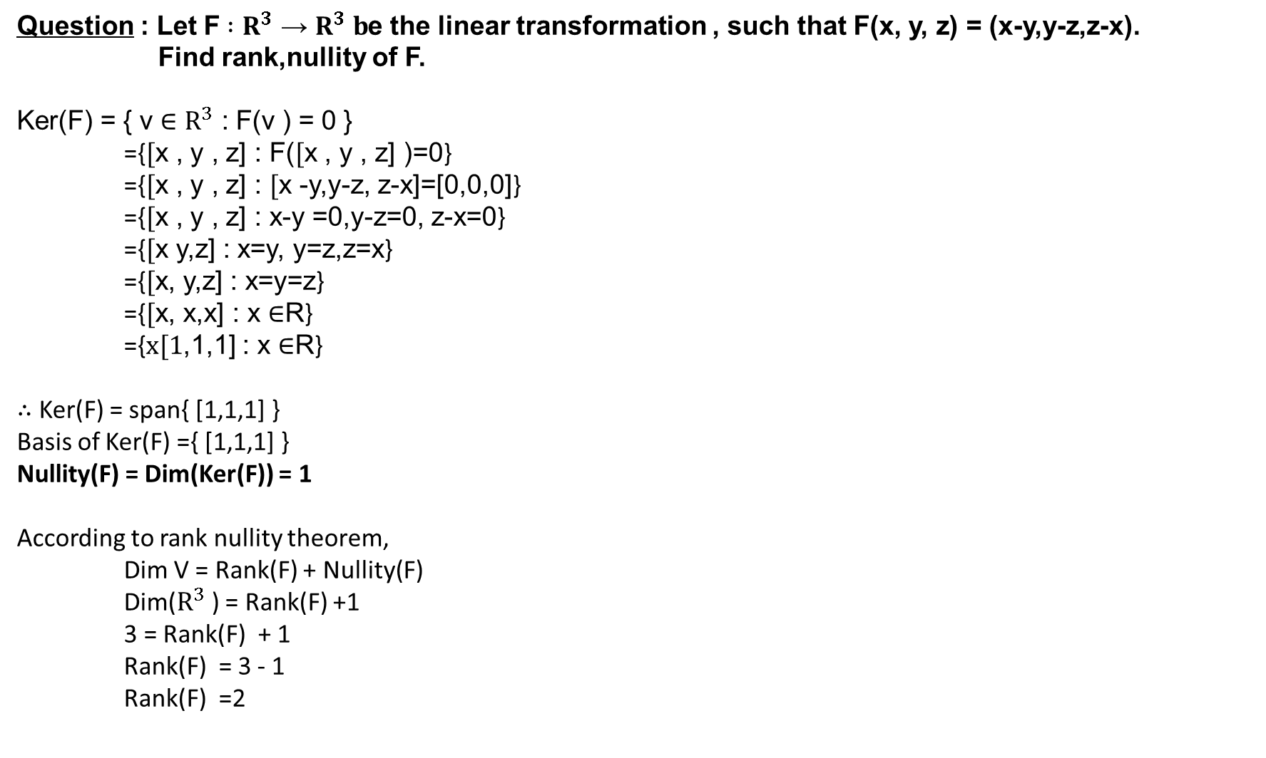
Question : Let F$:R^{3}$ → $R^{3} b$e the linear transformation , such that F(x, y, z) = (x-y,y-z,z-x).
Find rank,nullity of F.
Ker(F) = { v ∈ $R^{3}$ : F(v ) = 0 }
={$[$x , y , z] : F($[$x , y , z] )=0}
={$[$x , y , z] : $[$x -y,y-z, z-x]=[0,0,0]}
={$[$x , y , z] : x-y =0,y-z=0, z-x=0}
={$[$x y,z] : x=y, y=z,z=x}
={$[$x, y,z] : x=y=z}
={$[$x, x,x] : x ∈R}
={$x[1$,1,1] : x ∈R}
$∴$ Ker(F) = span{ [1,1,1] }
Basis of Ker(F) ={ [1,1,1] }
Nullity(F) = Dim(Ker(F)) = 1
According to rank nullity theorem,
Dim V = Rank(F) + Nullity(F)
Dim($R^{3}$) = Rank(F) +1
3 = Rank(F) + 1
Rank(F) = 3 - 1
Rank(F) =2

